Slide 1


Slide 2
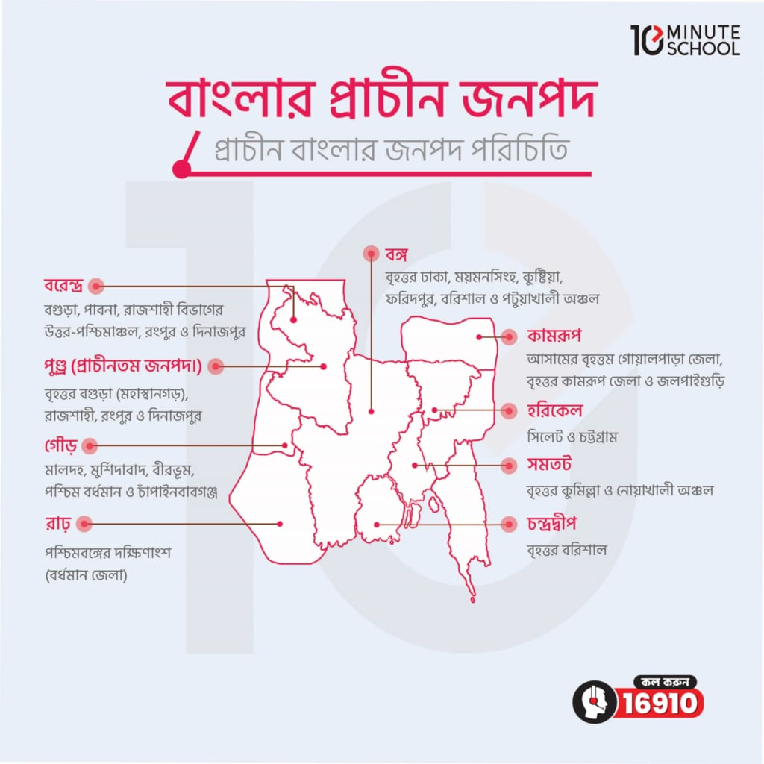
Ancient Janapad Of Bengal

Slide 3
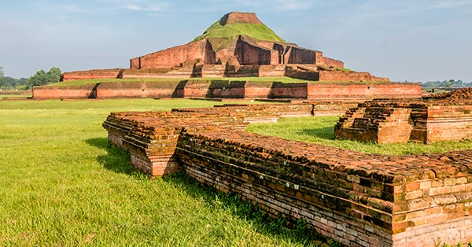
Definition Of Janapad
"Janapad," a Bengali term, translates to "settlement" or "habitat" and refers to regions or areas where groups of people live together, creating a social, political, and economic structure. This concept, although simple in its linguistic roots, carries deep historical, sociological, and geographical significance..

Slide 4
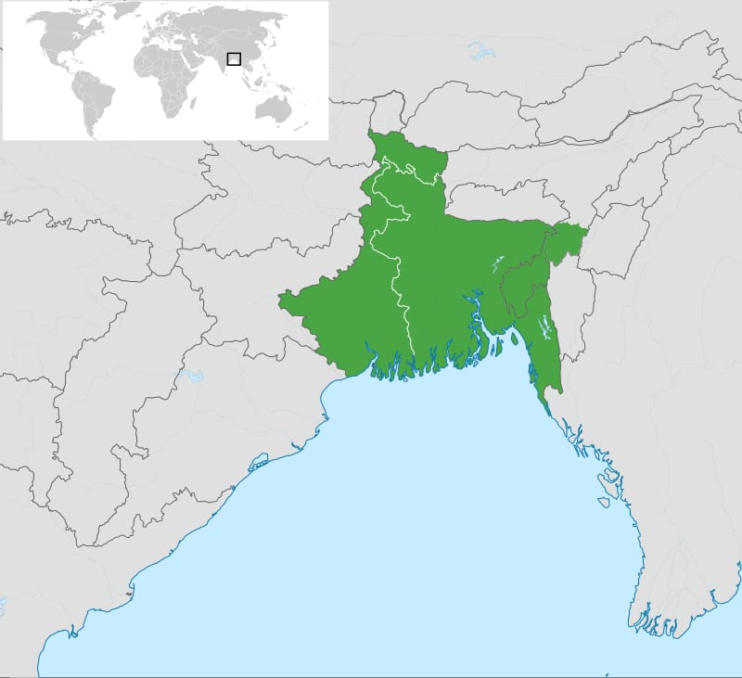
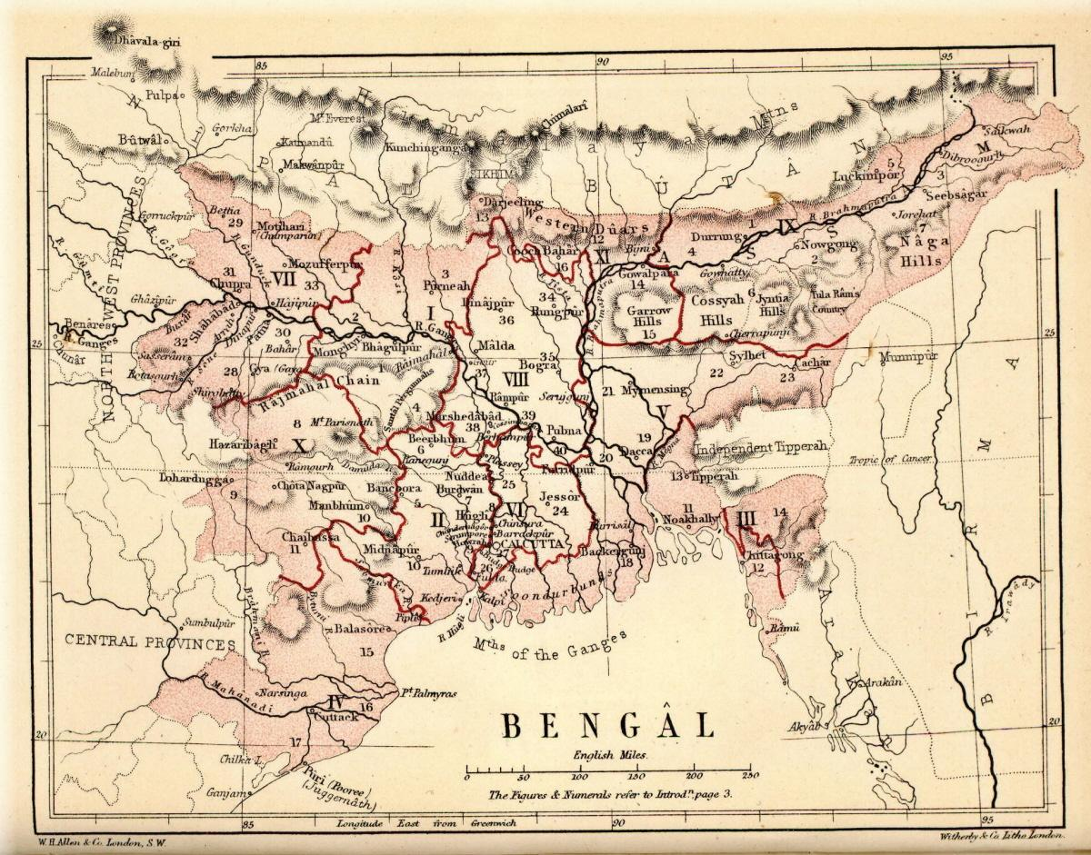
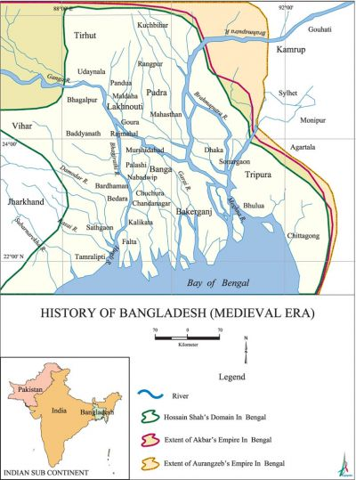
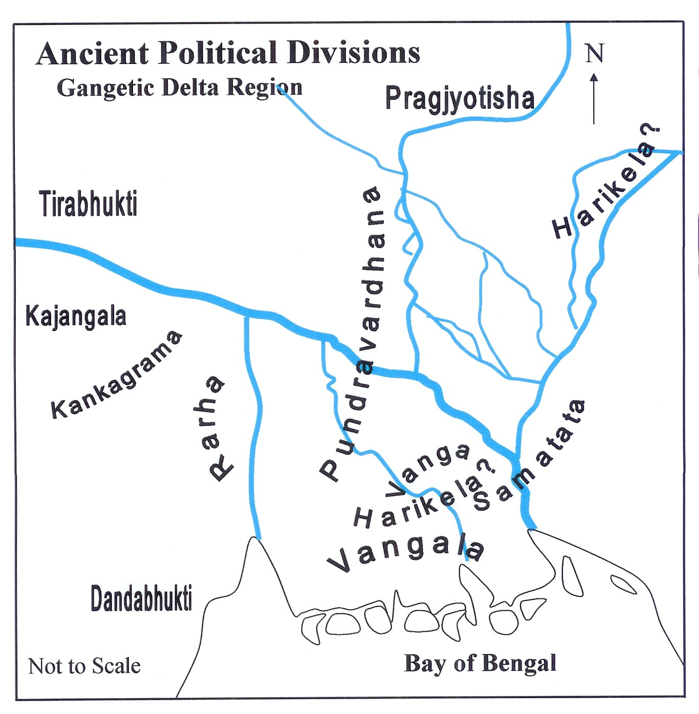
“Types Of Janapad”
The document discusses several ancent janapad that existed in Bengel prior to it becoming a unified state. It descrides 16 major janapads, Including:
Banga
Pundra
Samatata
Rarha

Slide 5
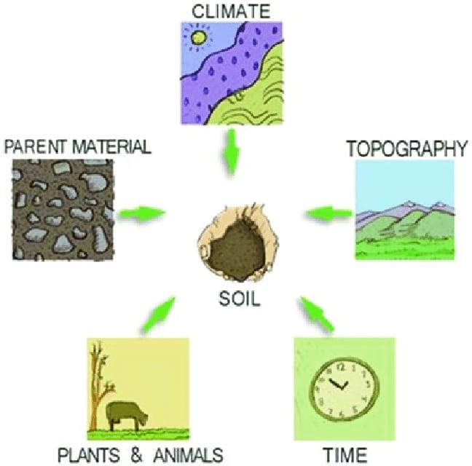
Factor Influence Janapad Formation
Throughout history, human beings have formed settlements to meet their needs for shelter, security, and community. The evolution of Jonopods in the Indian subcontinent can be traced back to ancient times, when human beings shifted from nomadic lifestyles to more permanent agricultural practices. The early Vedic period (around 1500 BCE) witnessed the formation of small settlements along river valleys like the Ganges and Indus, where fertile land supported agriculture and basic trade.

Slide 6

Historical Development Of Settelment
The historical development of settlements began with early human groups forming nomadic camps, gradually evolving into permanent villages as agriculture advanced. Over time, these settlements grew into towns and cities, influenced by trade routes, resources, and political power.

Slide 7
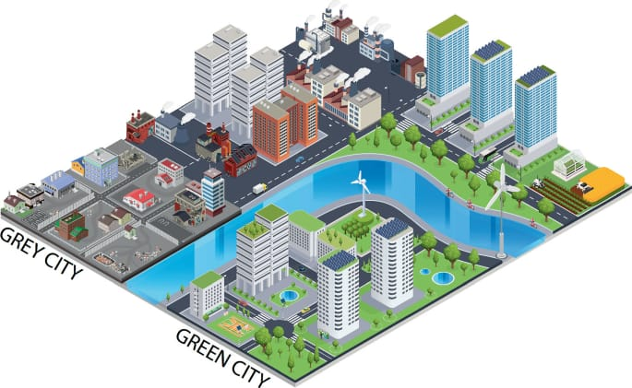
Modern Settlement And Challenge
Modern settlements face challenges such as urbanization, overcrowding, and inadequate infrastructure, leading to issues like housing shortages and environmental degradation. Additionally, the need for sustainable development and climate resilience adds pressure to modern urban planning.

Slide 8
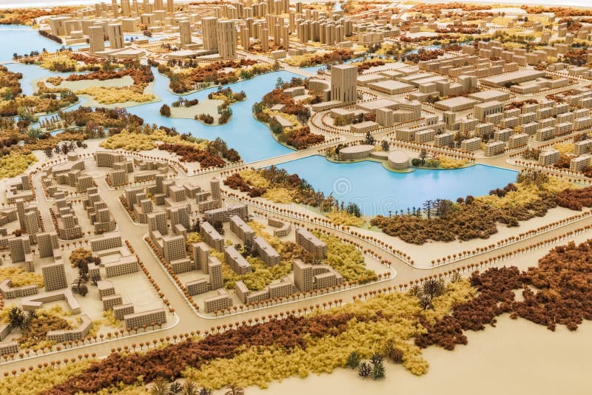
Conclusion
The concept of Janapad, though rooted in ancient times, continues to be an important idea in understanding the development of human societies. From small settlements to vast empires, Jonopods shaped the course of history, influencing politics, religion, culture, and economy. Today, as cities grow and rural areas change, the essence of Jonopod remains—a reminder of humanity's need to live, work, and grow together as a community. Understanding Jonopods is crucial for recognizing the interconnectedness of people, place, and the larger forces of history that shape our world.

Slide 9


